Slide 1

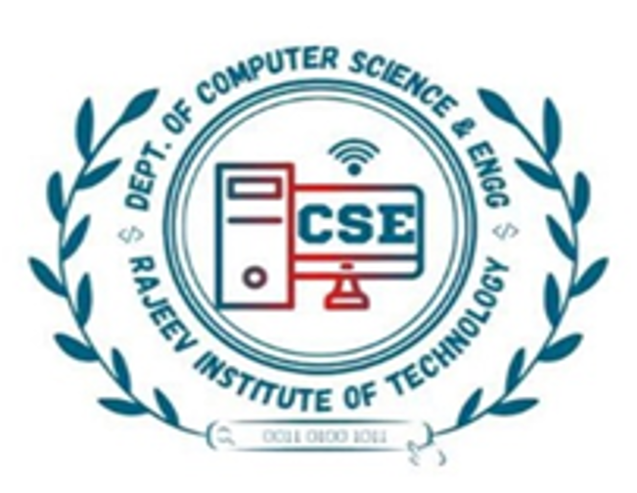
Rajeev institute of technology,
Hassan
DEPARTMENT OF COMPUTER SCIENCE AND ENGINEERING CG MINI PROJECT ON “ROCKET LAUNCH SIMULATION”
UNDER THE GUIDENCE OF,
MR. SANJAY M
ASSISTANT PROFESSOR,
DEPT OF CSE,
RIT HASSAN.
SUBMITTED BY,
SAKEENA IRAM : 4RA21CS074
SAHANA S.M : 4RA21CS073

Slide 2
CONTENTS
ABSTRACT
INTRODUCTION
OBJECTIVES
SOFTWARE & HARDWARE REQUIREMENTS
AVANTAGES & DISADVANTAGES
SNAPSHOTS
CONCLUSION

Slide 3
ABSTRACT
The rocket launching project is a 2D animation of a satellite launching process. In our project rocket will be static prior to launching. The aim of this project entitled “Rocket launching Simulation” is to build a graphics package using OpenGL technology & windows as the platform for compilation .
Once the rocket is launched, actual animation starts here. Rocket starts moving into the sky, after sometime it reaches the space. The next phase of the rocket launch is dismantling stage1, in this stage the first fuel supplier will be dismantled. Now rocket starts moving with the help of second fuel supplier. The next stage will be dismantling stage2, here the fuel supplier 2 will be dismantled

Slide 4
INTRODUCTION
Rocket Launch Simulation, we use advanced computer graphics to bring the excitement of a rocket launch to life! You’ll get to see a realistic and visually simulation of a rocket preparing for and executing its launch into space.. During a rocket launch, separation refers to the process of detaching or separating different stages or components of the rocket as it ascends into space. The separation events are crucial for the successful progression of the mission and are carefully planned and executed.
The “ Rocket Launching is an exciting venture aimed at creating a realistic computer generated simulation of rocket launch.

Slide 5
OBJECTIVES
Here are some common objectives for a rocket launch simulation in computer graphics:
Showcase Rocket Launch Basics : Demonstrate the stages of a rocket launch with detailed graphics.
Engage and Educate the Audience: Provide an interactive and visually engaging experience to spark interest in space exploration and inspire future scientists and engineers.
Explore Space Exploration Careers: Inspire and inform viewers about various career opportunities in the fields of aerospace engineering, astronomy, and space science.

Slide 6
Hardware/Software Requirements
Software:
Operating System | Windows 7+ or Ubuntu
Application Used | Code Blocks or Terminal
Graphics | OpenGL
Language | C / C++
Hardware:
Processor | processor with a speed of 2.0GHz
RAM | 512 MB or more
Hard disk | 10+ GB or more

Slide 7
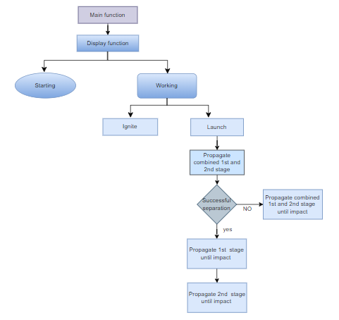
FLOWCHART

Slide 8
ADVANTAGES
Cost-Effective Development: Building and launching rockets for testing purposes can be extremely costly. CG simulations provide a cost-effective alternative to physically constructing and launching rockets.
Safety: Conducting real rocket launches involves inherent risks. Simulations allow engineers to test various scenarios in a controlled environment without endangering human lives or risking expensive equipment.
Educational Purposes: Simulations can be used for educational purposes to teach students or enthusiasts about the principles of rocketry, physics of spaceflight, and the challenges of launching rockets into space.

Slide 9
DISADVANTAGES
Simulation Accuracy: Simulations may not always accurately reflect real-world conditions due to simplifications or assumptions made in the modeling process.
High Computational Requirements: Simulations need powerful hardware for smooth performance.
Complex Development Process: Creating realistic simulations is time-consuming and complex.
Limited Realism: Simulations may not capture all real-world conditions accurately.

Slide 10
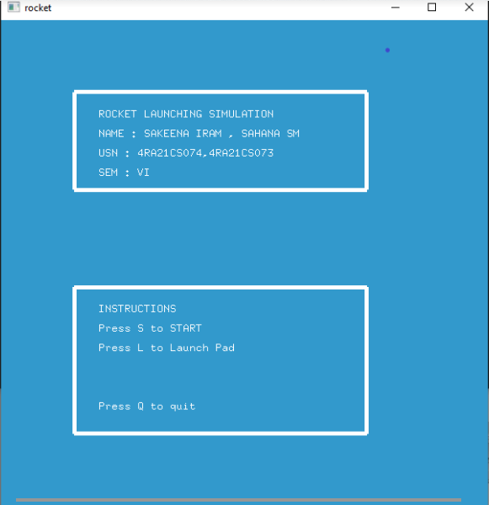
SNAPSHOTS

Slide 11
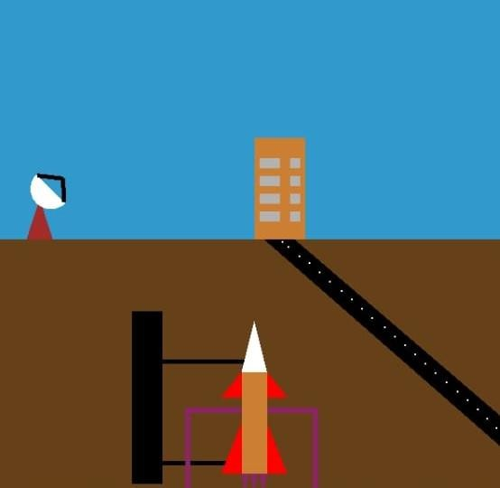
Launch Pad

Slide 12
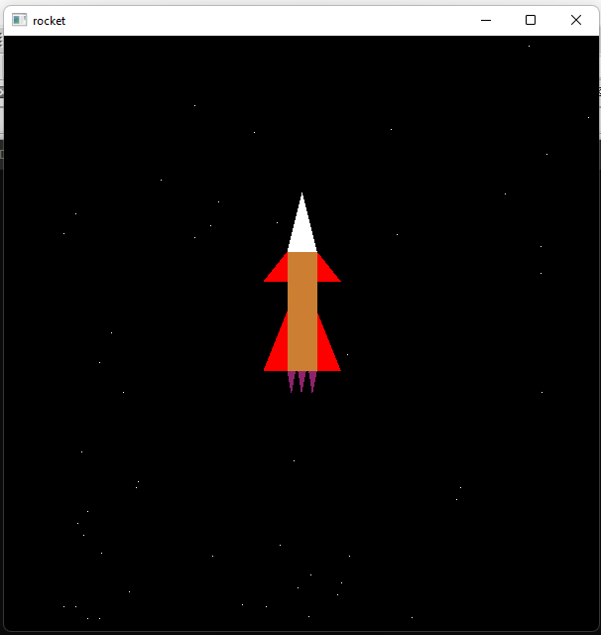
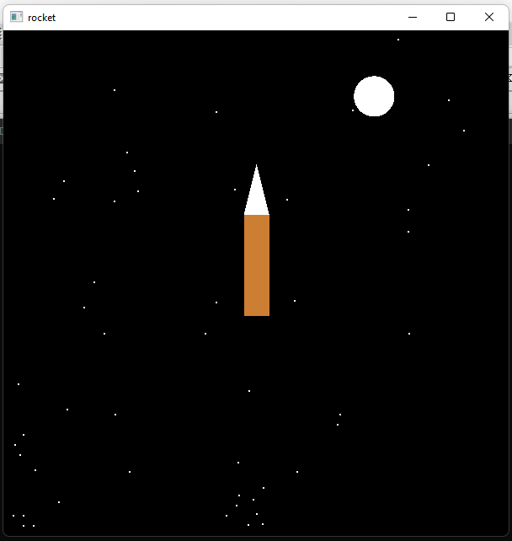
Stage 1
Stage 2

Slide 13
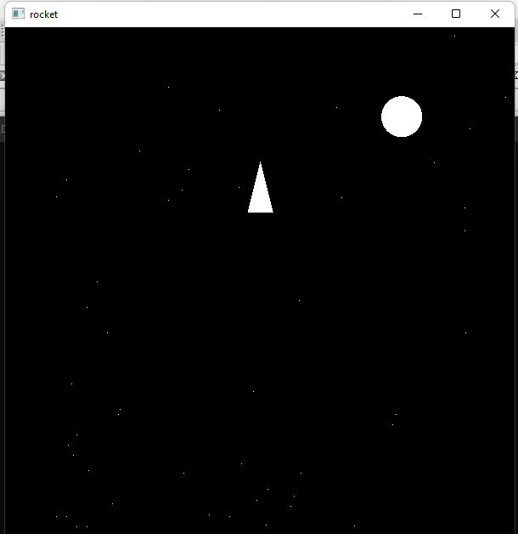
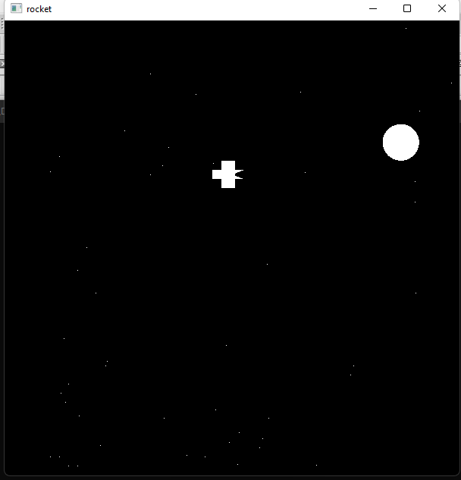
Stage 3
Satellite

Slide 14
CONCLUSION
In conclusion, the project implemented a rocket launching simulation using computer graphics techniques. The primary objective of the project was to provide a realistic and immersive experience for users to visualize the process of rocket launching.
Overall, the rocket launching simulation project served as a valuable learning experience in the field of computer graphics. It provided insights into the challenges of creating realistic simulations and highlighted the importance of physics-based modeling and rendering techniques .The project has the potential to be a useful tool for educational purposes, allowing students and enthusiasts to gain a better understanding of the intricacies of rocket launches.

Slide 15
Thank You

